Slide 1
Final Project Presentation
Group 5
Title: AES-128

Slide 2
Introduction
Purpose: AES-128(Advanced Encryption Standard) is a symmetric encryption algorithm that encrypts and decrypts data using a fixed-length key (128 bits).
AES-128 can be used to protect the privacy of sensitive data, ensuring security during transmission and storage.

Slide 3
Project scope
Background Introduction : It can be traced back to 1997 when finding a new advanced encryption standard to replace the then-used Data Encryption Standard (DES). DES was considered insecure due to its 56-bit key length.
What FPGA platform to implement on : KV260
Target Specification : throughput, latency or area

Slide 4
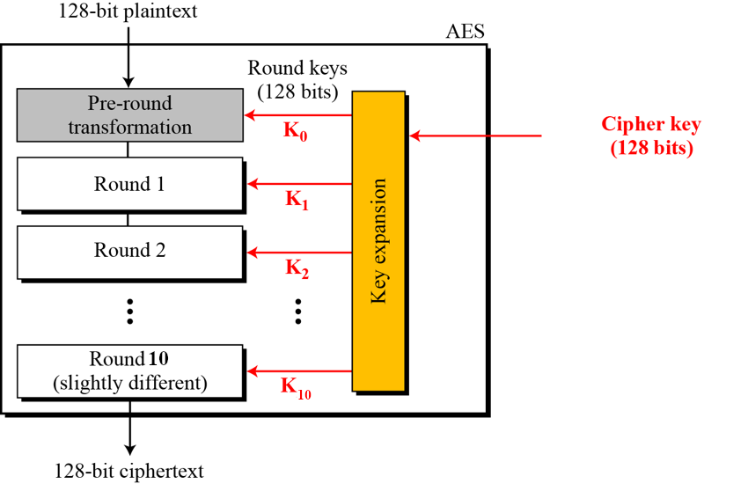
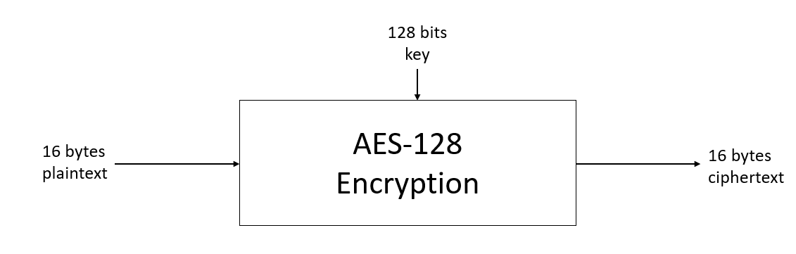
Project scope
System block diagram

Slide 5
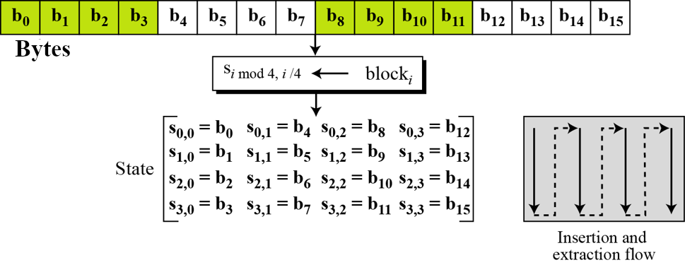
Transform input bytes to state

Slide 6
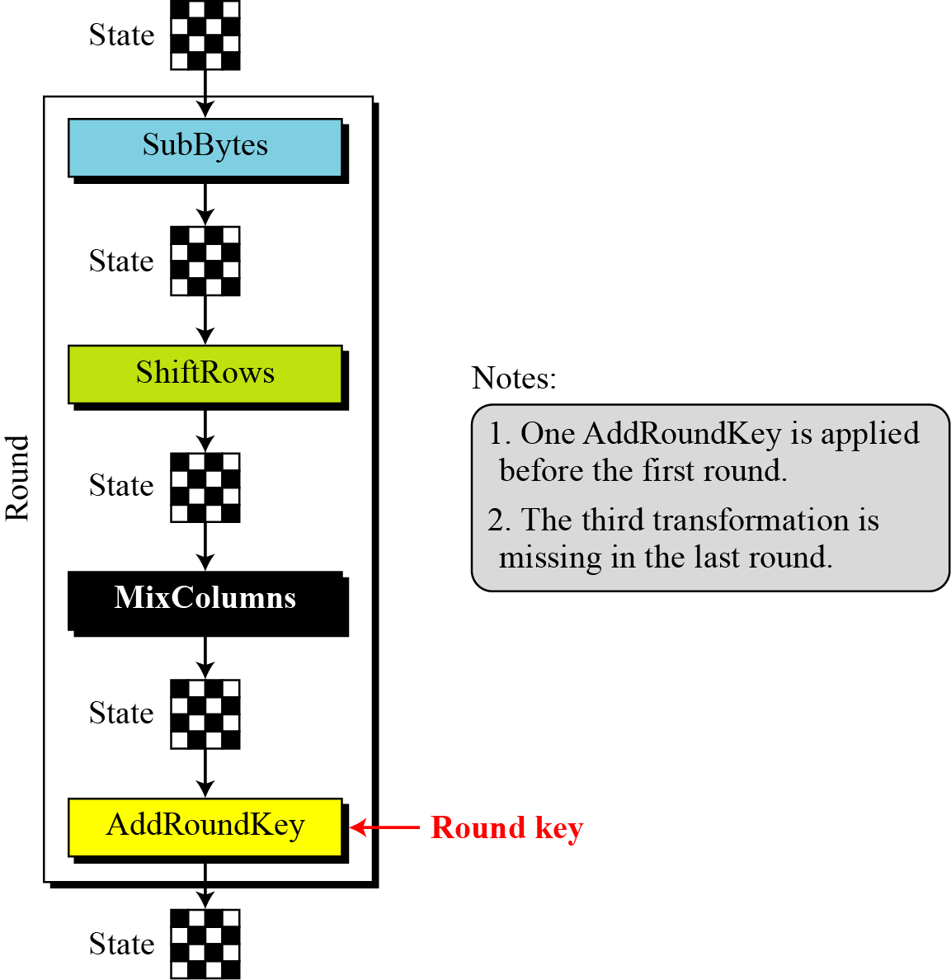
The structure of each round

Slide 7
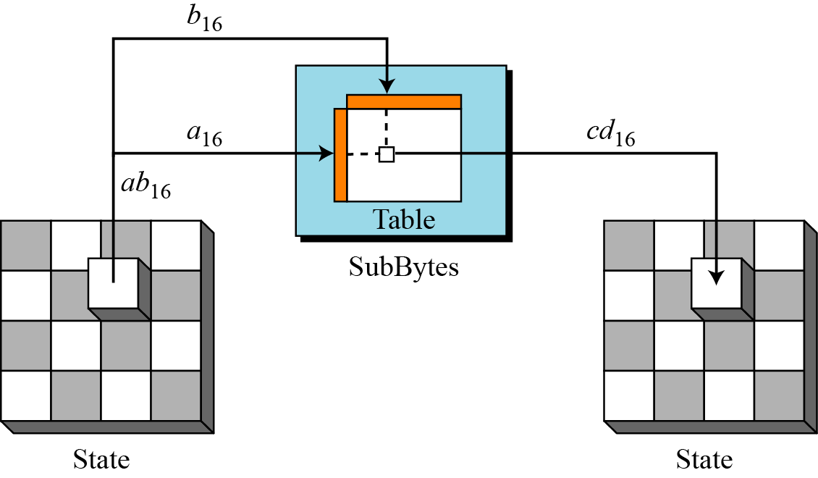
SubBytes
Substitute each bytes according to the lookup table.

Slide 8
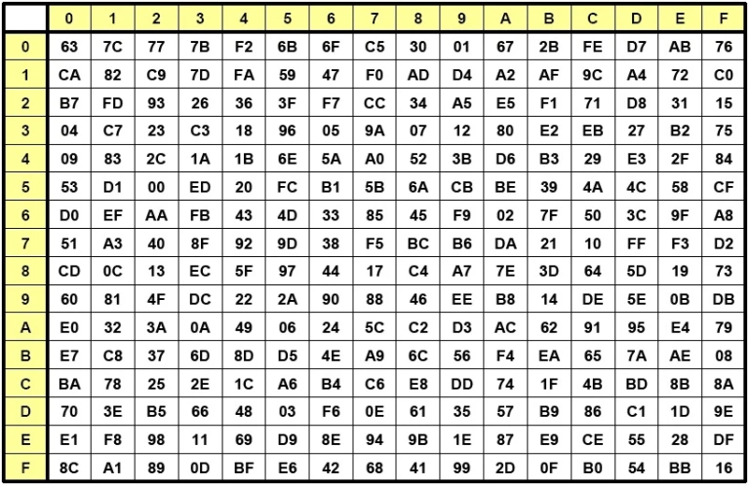
Lookup table for SubBytes

Slide 9
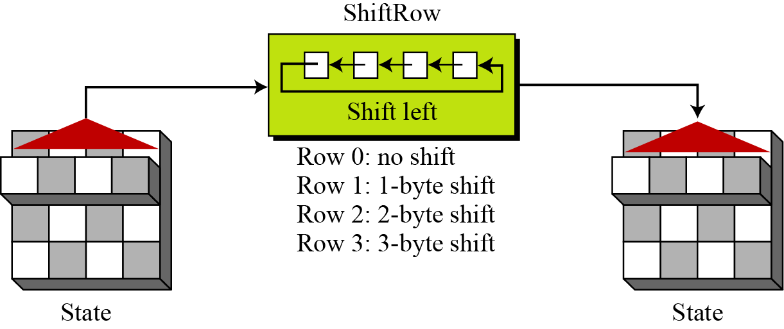
ShiftRows
Shift the bytes in each row cyclically.

Slide 10
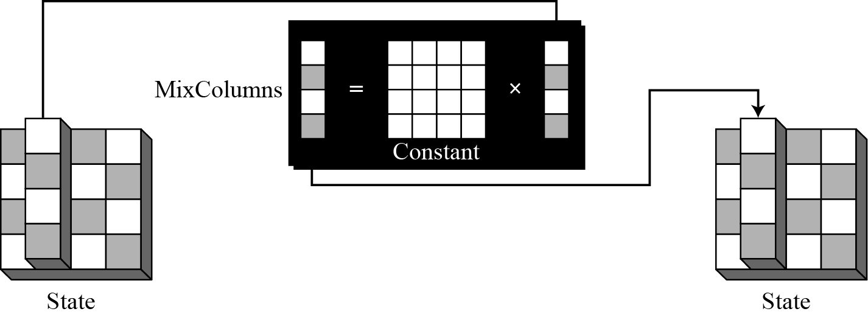
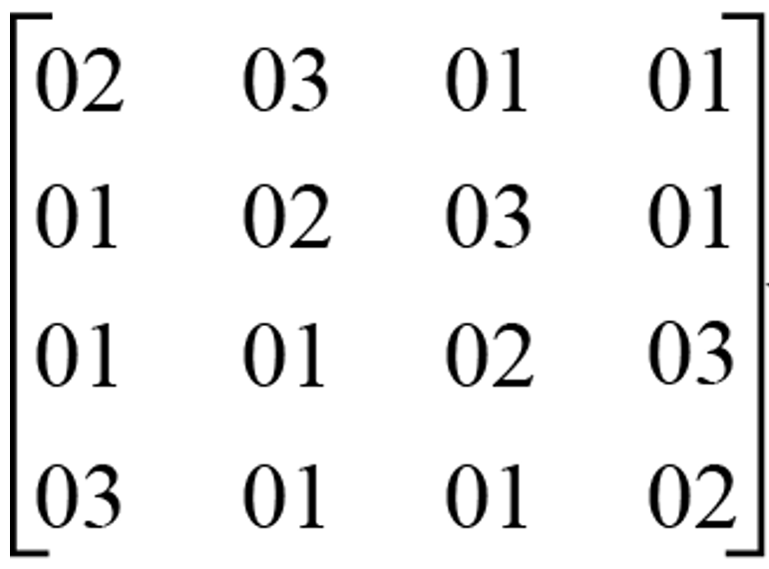
MixColumns
Each column of the state block is mixed using a matrix multiplication operation in GF(2^8).

Slide 11
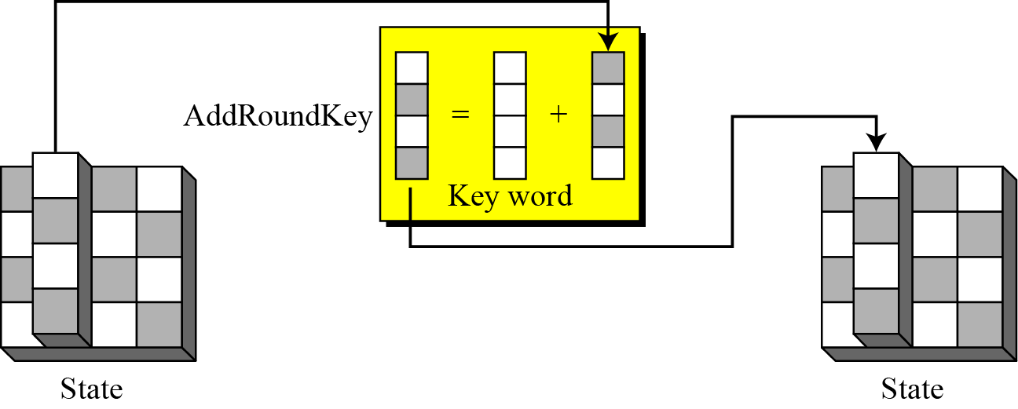
AddRoundKey
The round key for the current round is combined with the state block using bitwise XOR.

Slide 12
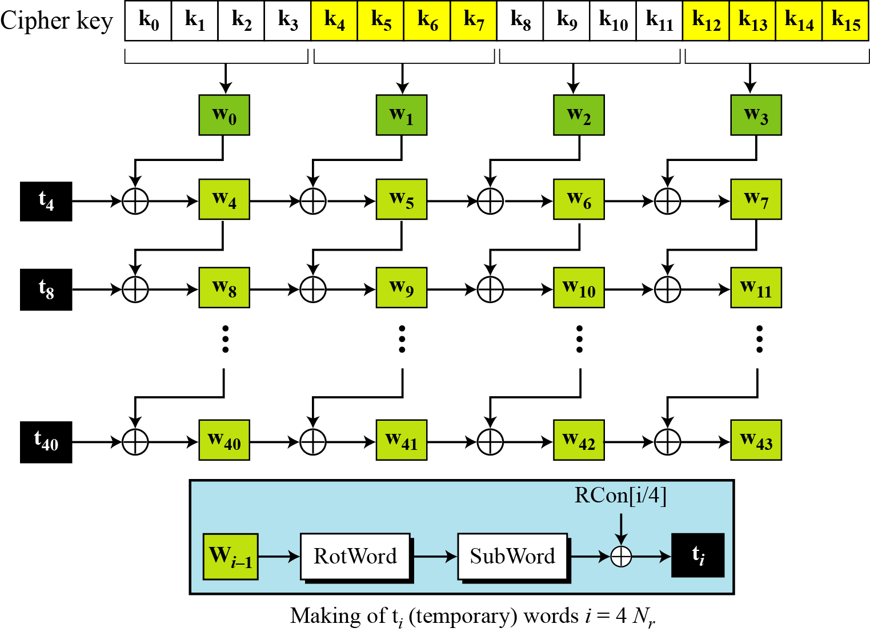
Key Expansion
Round key 0
Round key 1
Round key 2
Round key 10

Slide 13
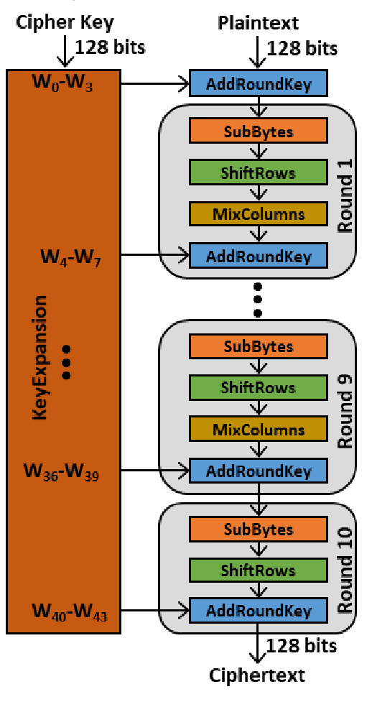
Complete AES-128 Encryption process

Slide 14
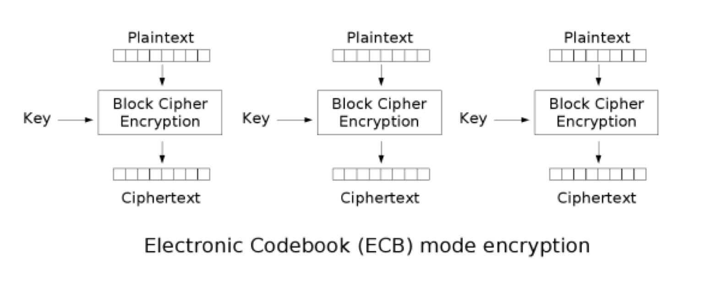
Project scope
Only support AES-128 ECB mode
Operation flow
Program cipher key
Stream in plaintext / Stream out ciphertext

Slide 15
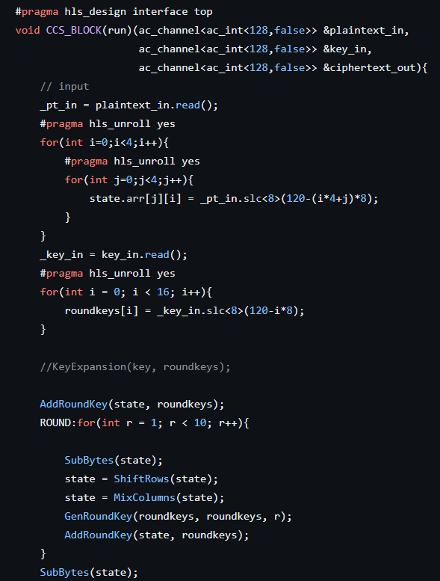
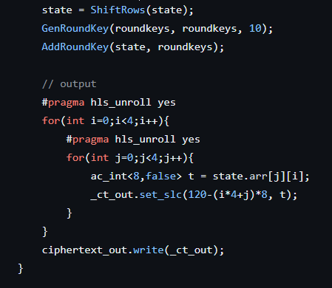
HLS work
This is the encryption part. The key is generated by GenRoundKey. You can see that a state array is first declared to store the plaintext, and then the array is subjected to a series of operations such as SubBytes, ShiftRows, MixColumns, and AddRoundKey with keys. After repeating 10 times, the ciphertext is obtained.

Slide 16
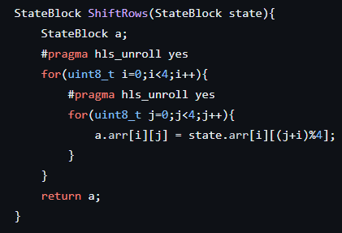
ShiftRows:
The nth column of array shifts n bytes.

Slide 17
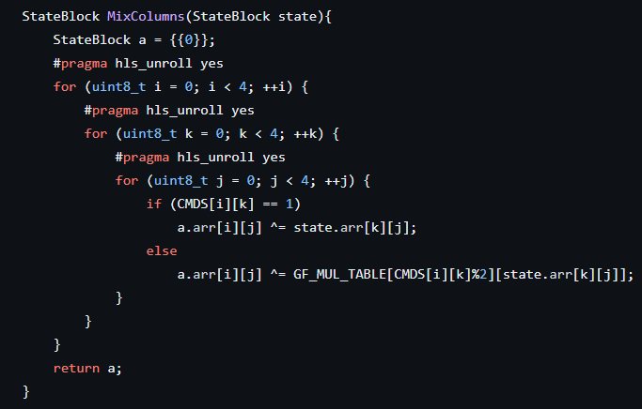
MixColumns:
Here we use the Galois Field table we provide to do mixcolumns.

Slide 18
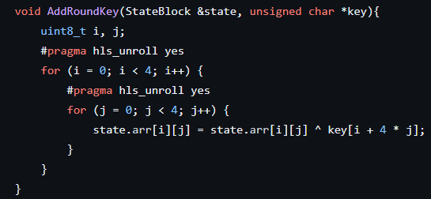
AddRoundKey:
Here we use key and state to calculate the new state.

Slide 19
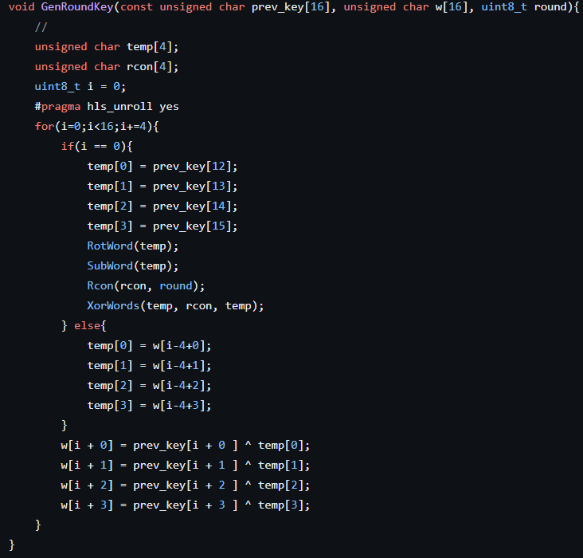
GenRoundKey:
Here is key expansion. Use this function to generate the 10 keys we need.

Slide 20
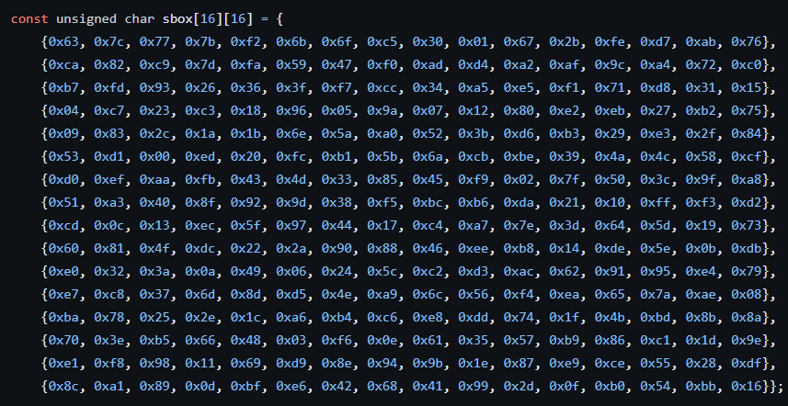
Sbox table:

Slide 21
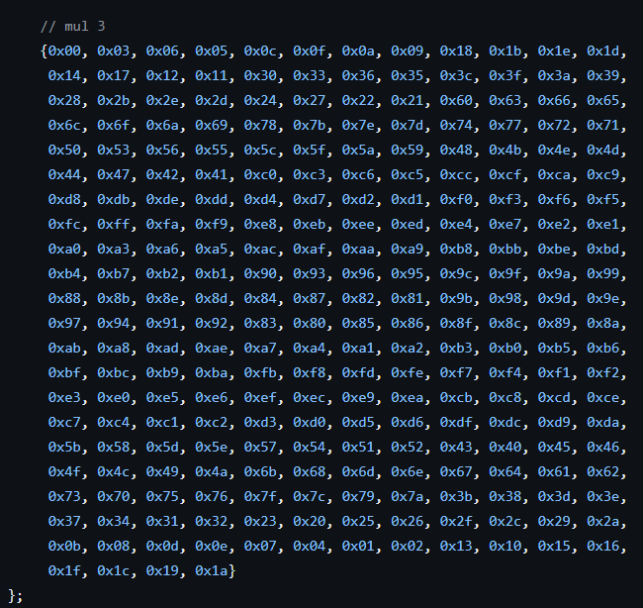
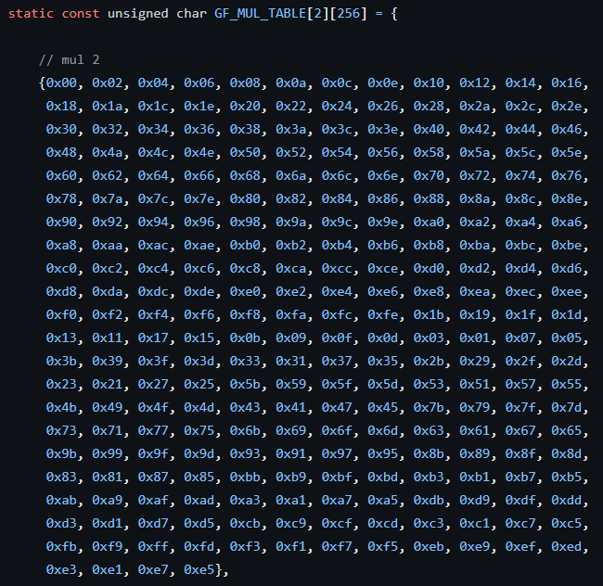
Galois field table:

Slide 22

CMDS table:

Slide 23
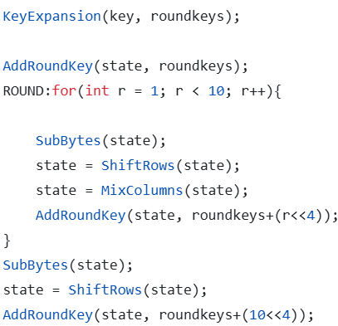
Micro-architecture exploration
Original design

Slide 24
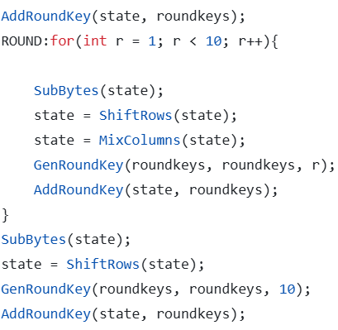
Micro-architecture exploration
v2

Slide 25
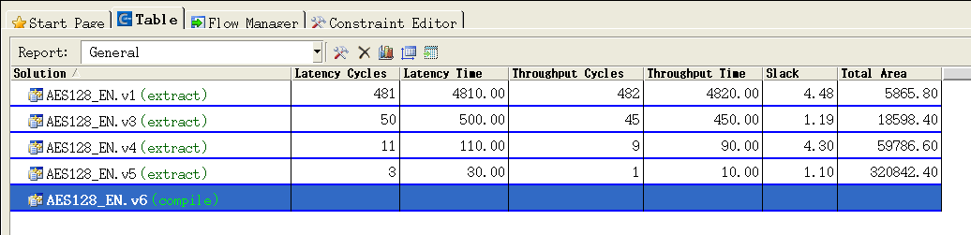
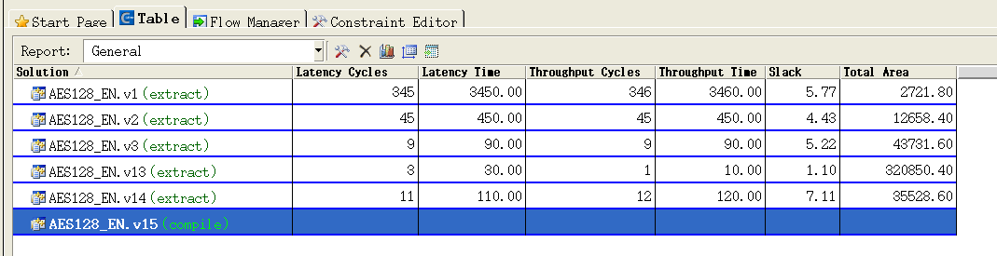
Catapult HLS Result
Original design
v2

Slide 26
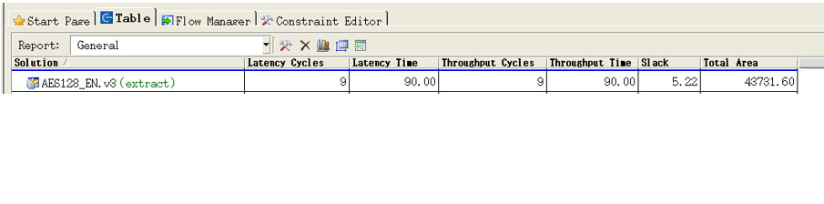
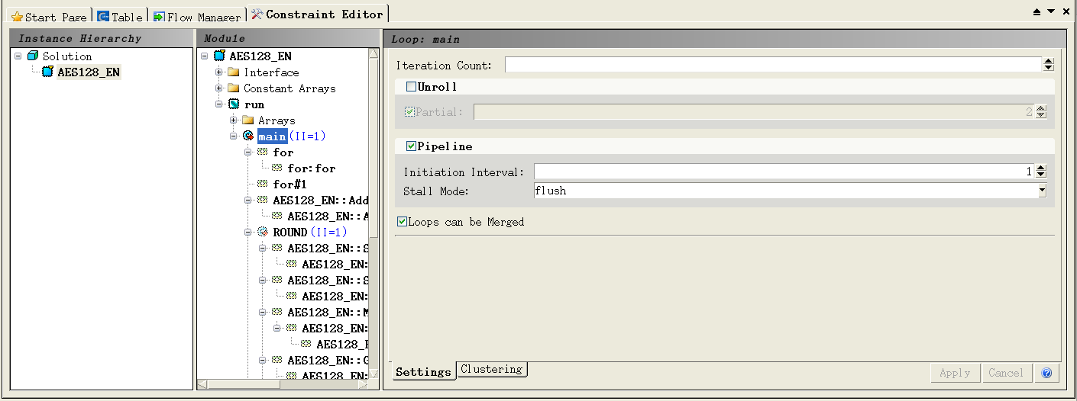
Problems we’ve encountered
Catapult GUI crashes quite often
Pipeline?

Slide 27
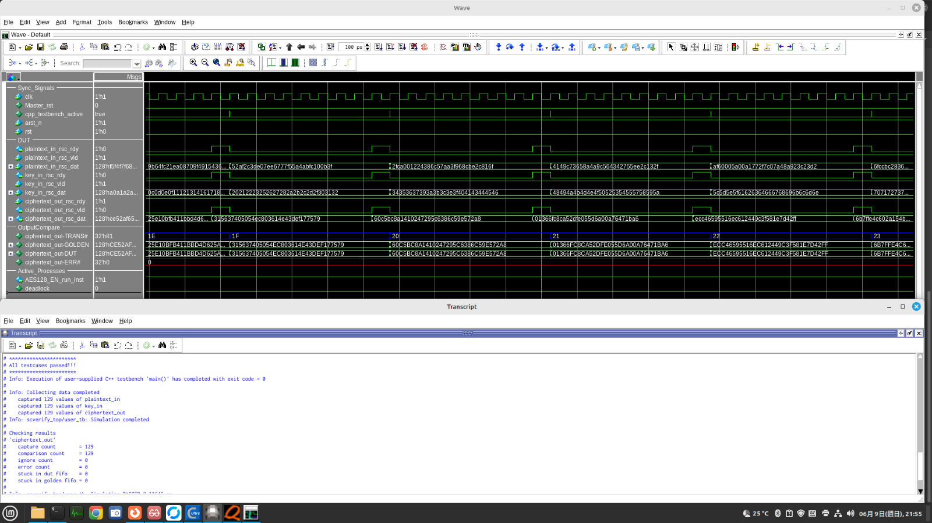
SCVerify

Slide 28
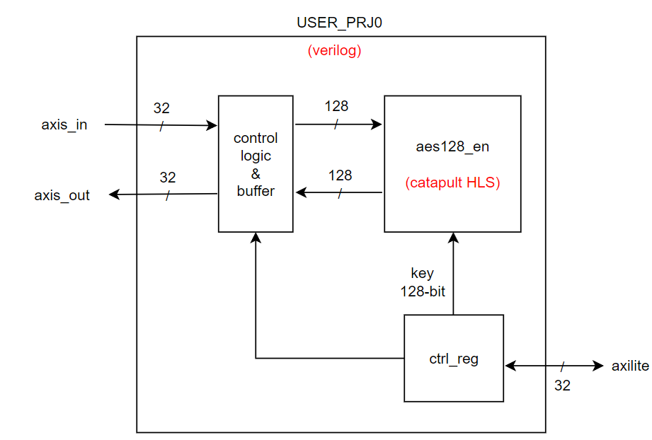
Integrating into FSIC
The input and output of our aes128_en is 128-bit, but the width of axi-stream in FSIC is only 32-bit. Therefore, a control logic is added to deal with the problem.

Slide 29
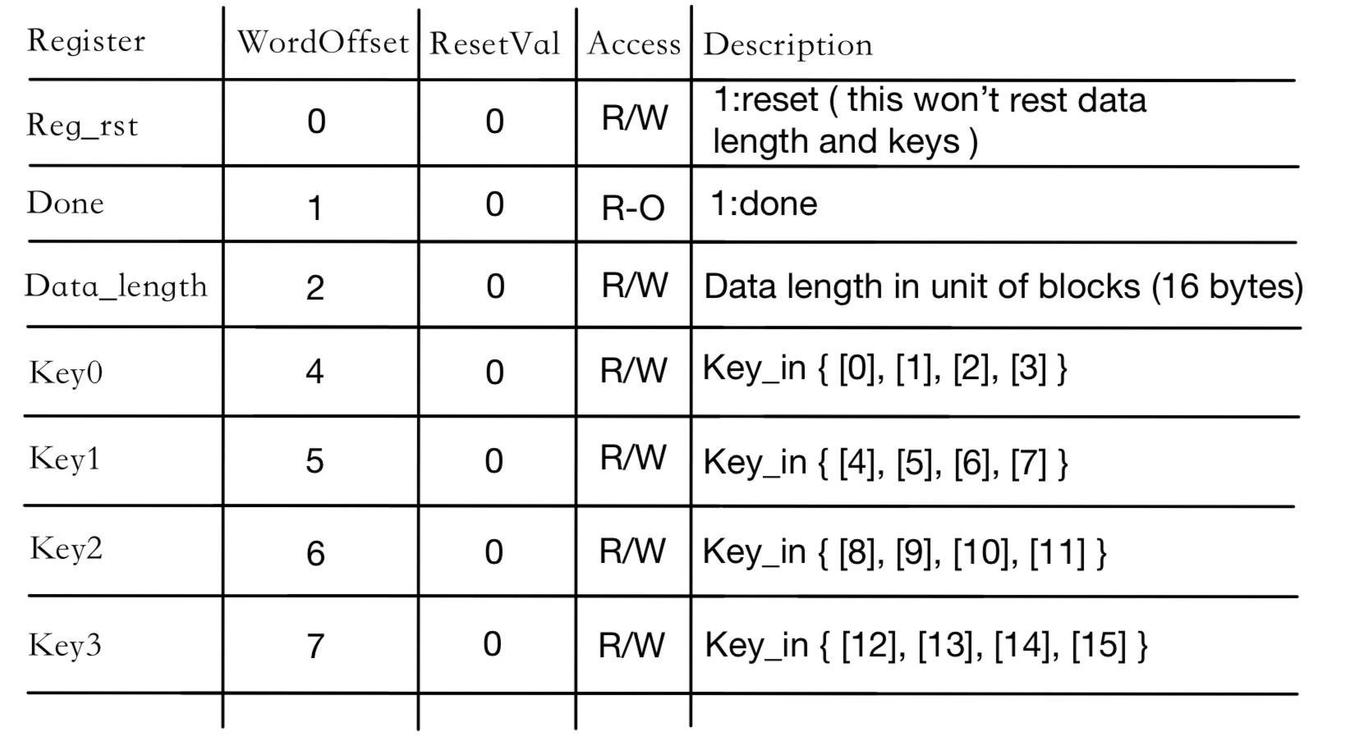
Control register map

Slide 30
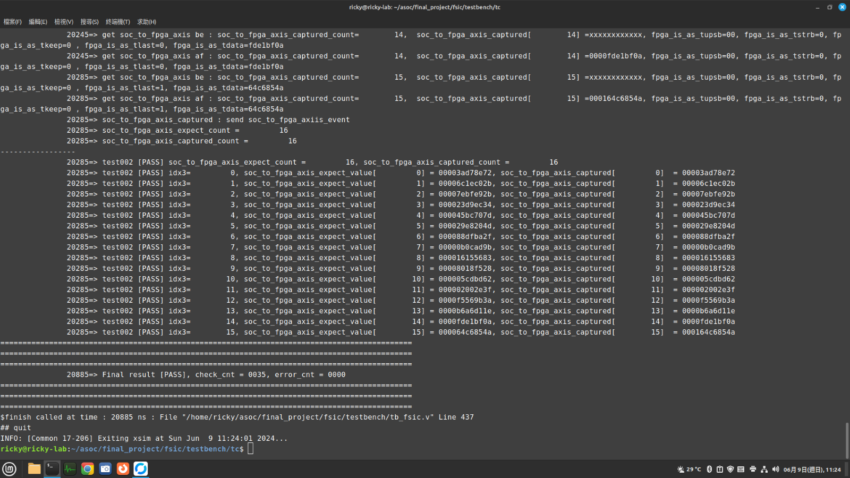
Simulation result

Slide 31
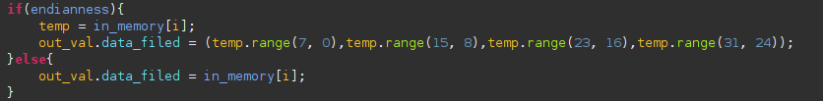
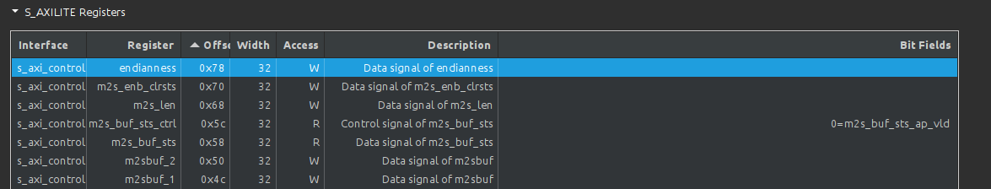
USER DMA
Because our application accelerator is big endian, but the rest of the system is little endian. We added a register in user dma to control the conversion.

Slide 32
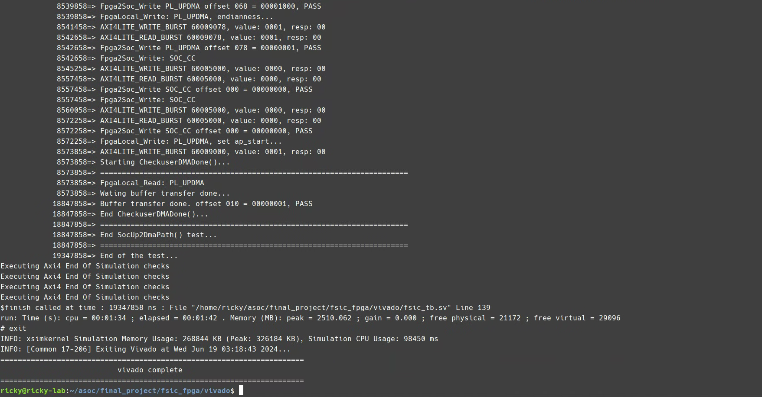
FPGA Simulation
Successfully passed. All output data are correct.

Slide 33
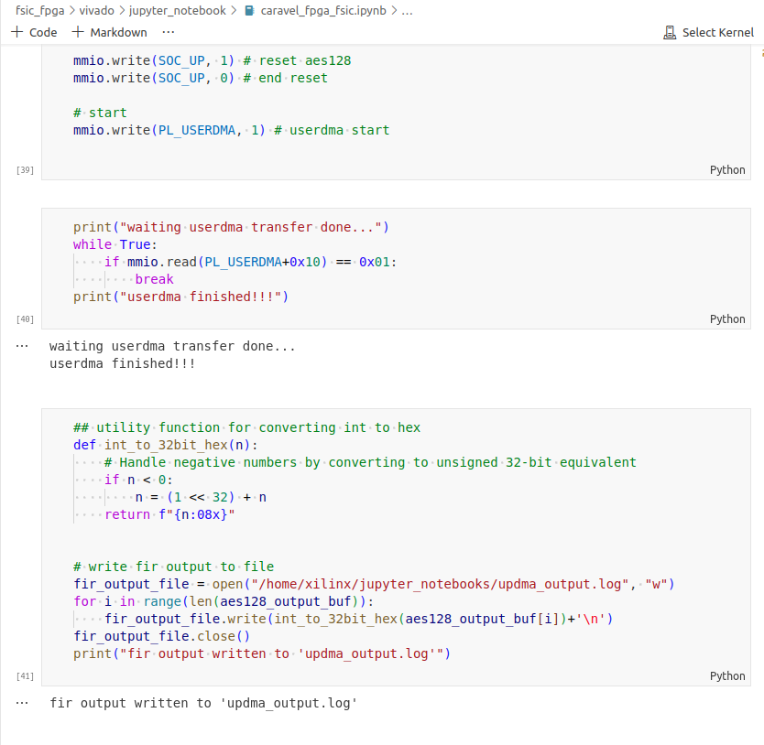
FPGA Emulation
Successfully passed
and no pynq board was killed by us😁

Slide 34
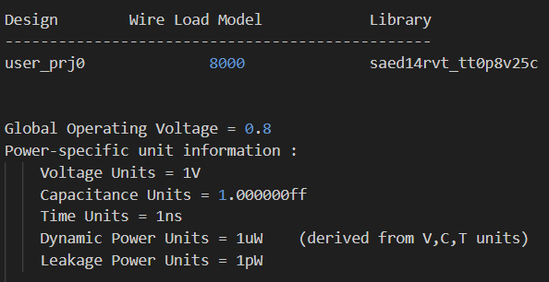
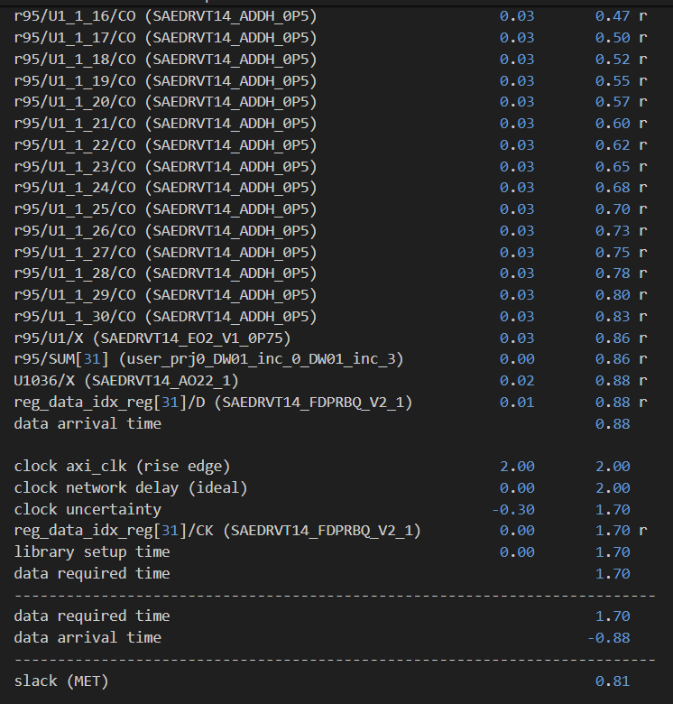
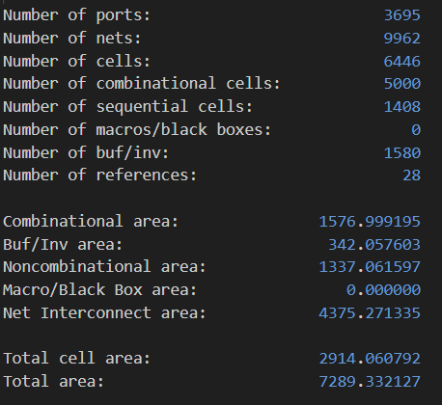
Synthesis

Slide 35
Synthesis problem
We mentioned earlier that we use a lookup table, but the synthesized circuit seems to have no ROM. It is speculated that we need additional settings during synthesis.

Slide 36
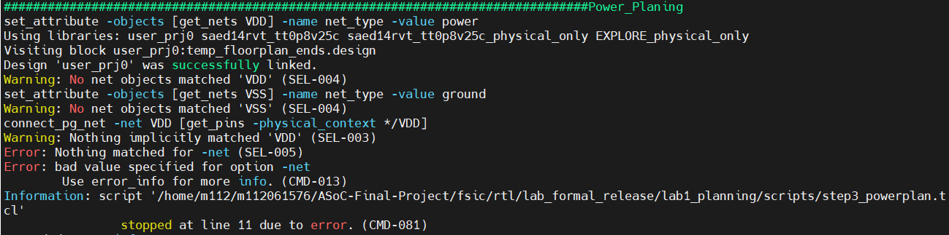
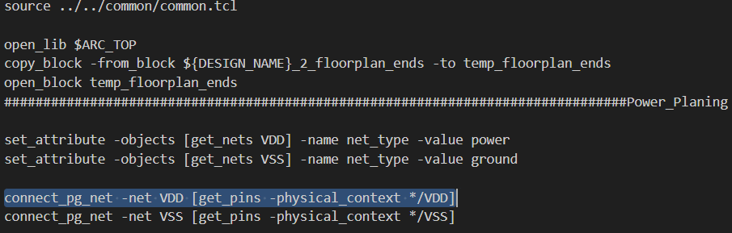
Floorplan

Slide 37
Error
floorplan:
An error occurred when executing the power plan. From the previous i2c_master_top.v of lab3, we learned that the input of this file includes vdd and gnd. And our own design does not have vdd, gnd.
It is speculated that i2c_master_top is a small circuit and may not need a power ring, so it directly provides vdd and gnd to the circuit.

Slide 38
Reference
NIST FIPS 197 Advanced Encryption Standard (AES) https://csrc.nist.gov/pubs/fips/197/final
Cryptographic Standards and Guidelines - AES Development https://csrc.nist.gov/projects/cryptographic-standards-and-guidelines/archived-crypto-projects/aes-development
GitHub link of our work: https://github.com/ruei7916/ASoC-Final-Project

